Slide 1

Checklist For Elderly Living Alone
Salt Lake County, Utah
Notes:
In United States elderly people comprise of 54.1 million population. In Utah almost 15.8% is aged 60 or above. In the salt lake county around 30000 are the elderly population as per 2021.

Slide 2
Services Offered for Elderly
Advocacy & Ombudsman
Information & Assistance
Caregiver Support
Home & Community Based Care
Housing Liaison
Legal Services
Medicare Counceling
Meals On Wheels
Rides For Wellness
Yard Care & Snow Removal

Slide 3
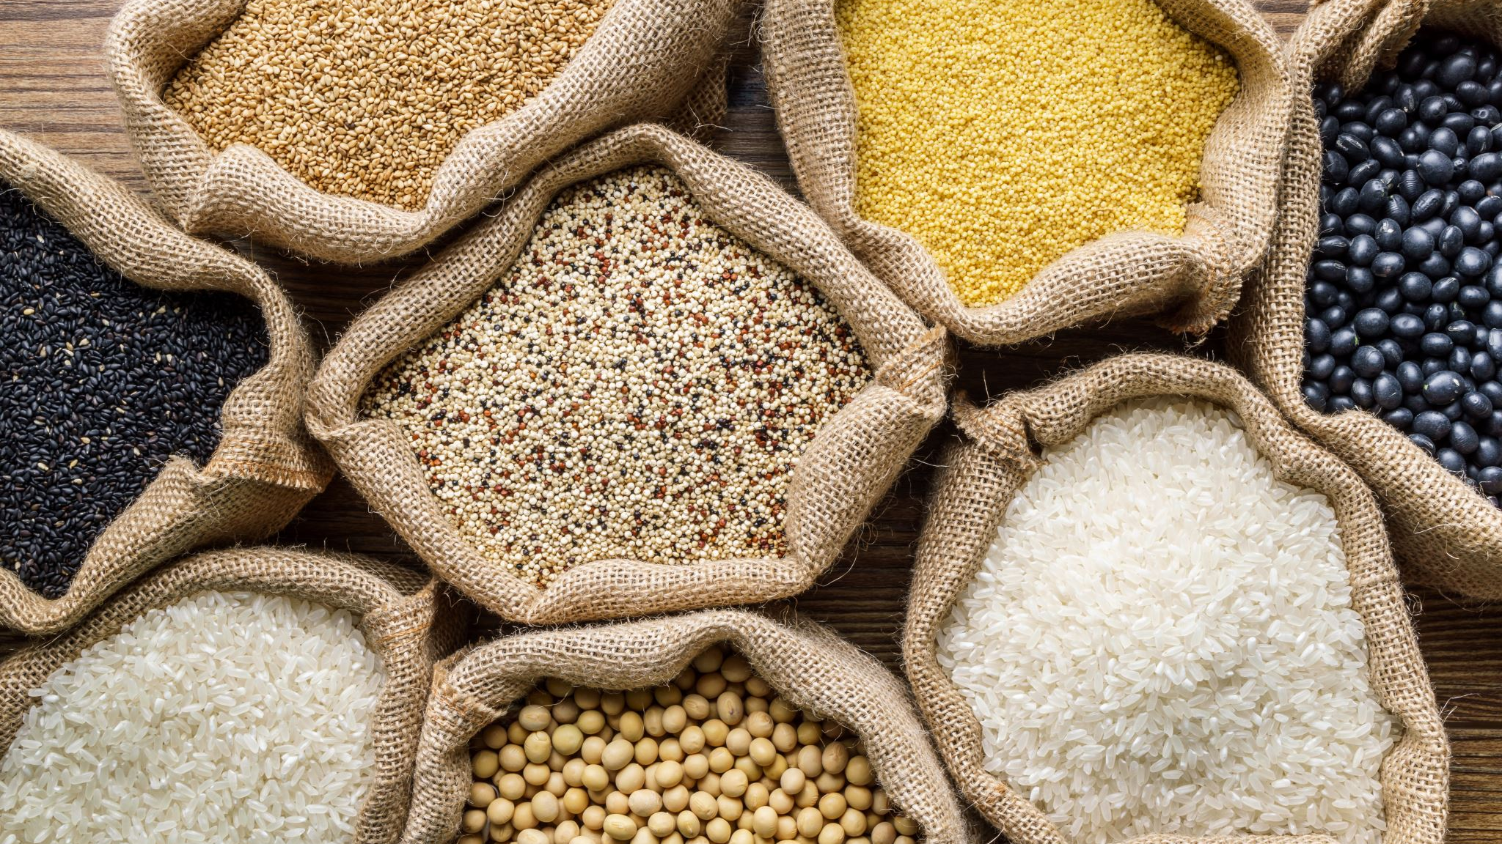
Analysis On Meals On Wheels Program

Slide 4
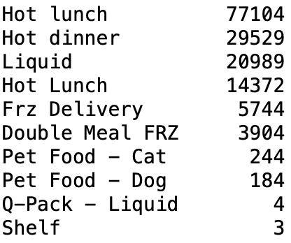
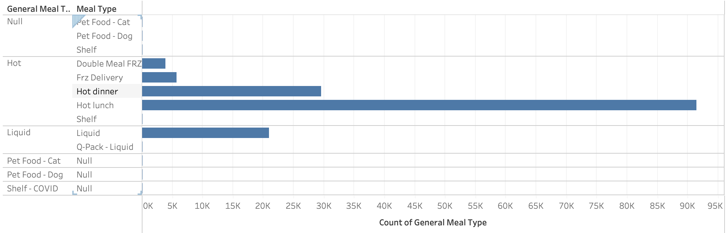
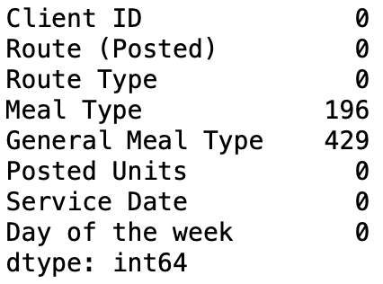
Exploratory Data Analysis - 2022

Slide 5
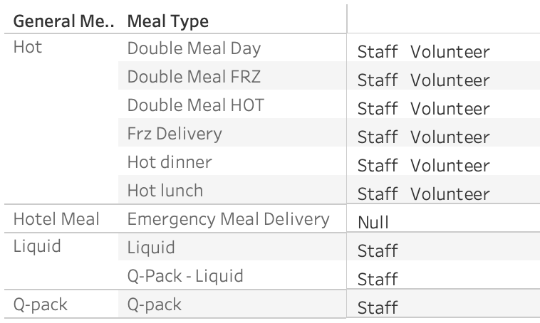
Exploratory Data Analysis 2021

Slide 6
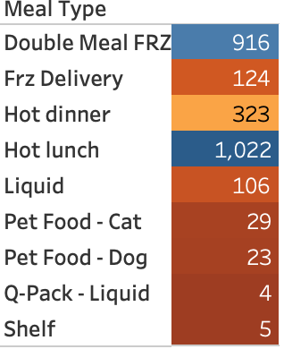
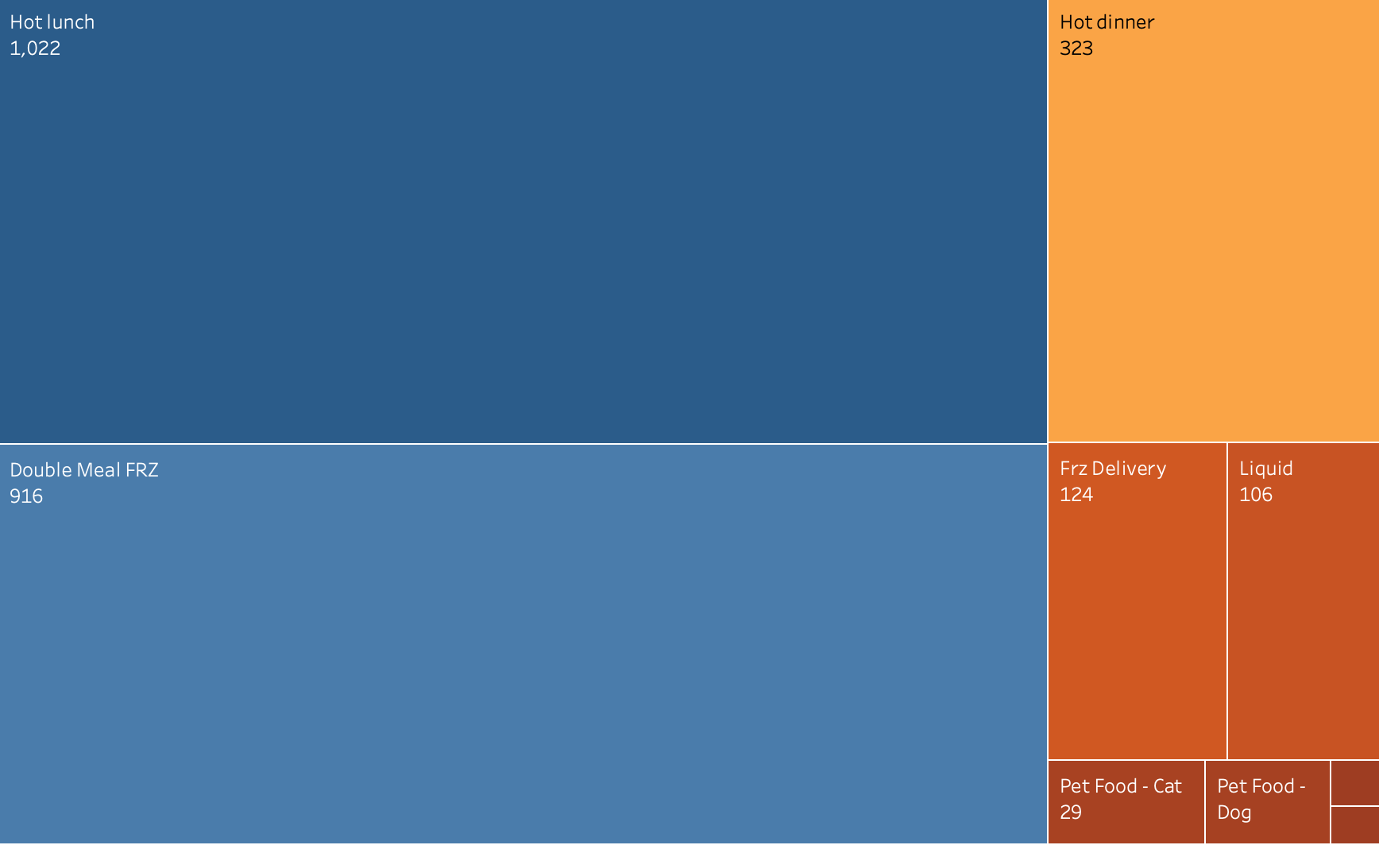
Clients & Services - 2022

Slide 7
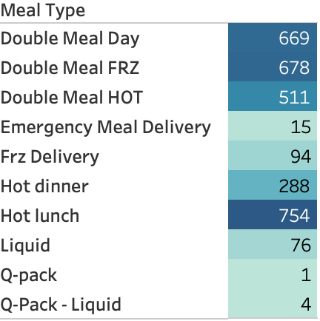
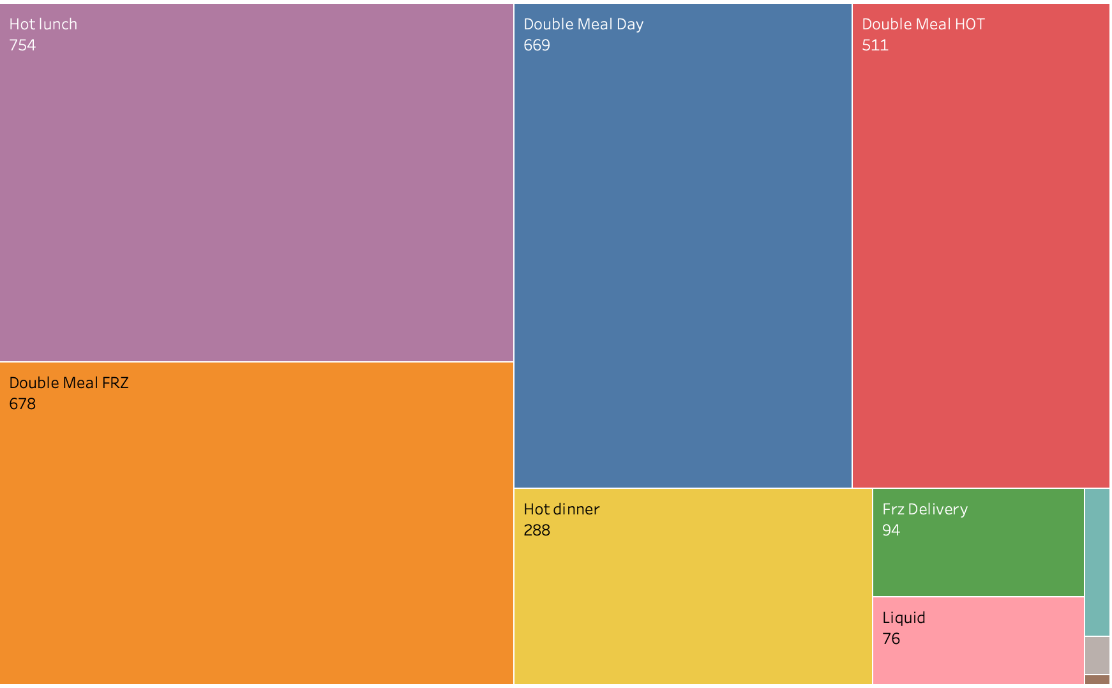
Clients & Services - 2021

Slide 8
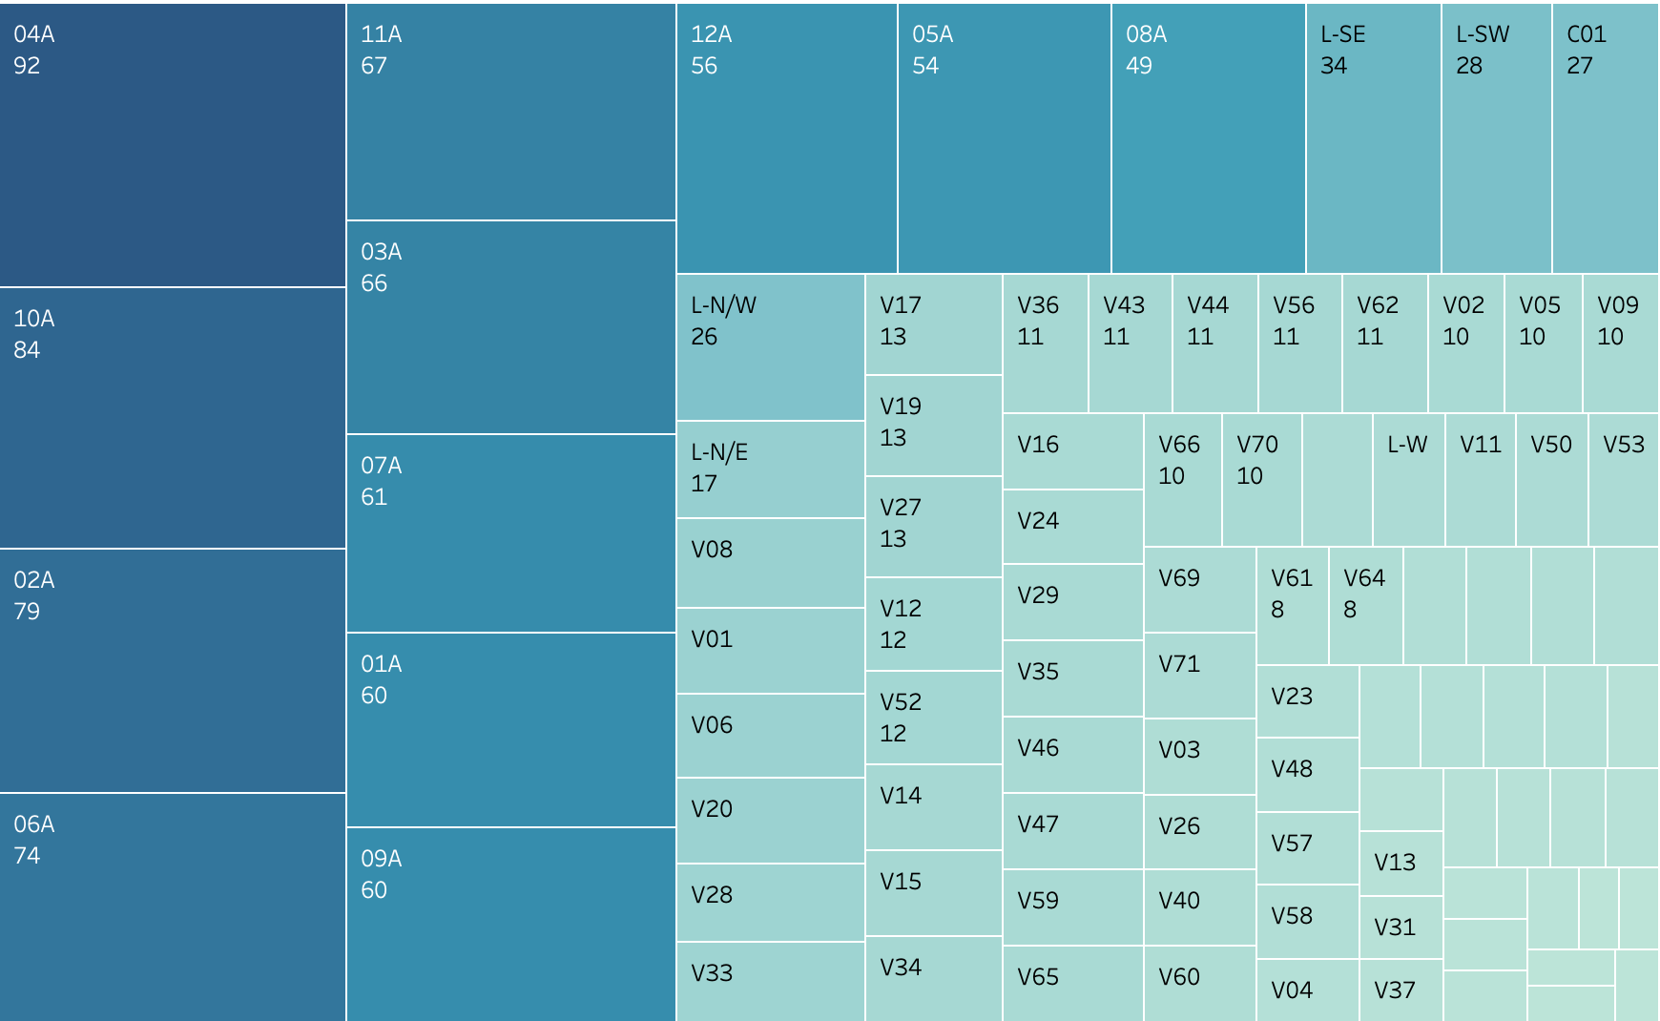
Total Number of Clients in each Route - 2022

Slide 9
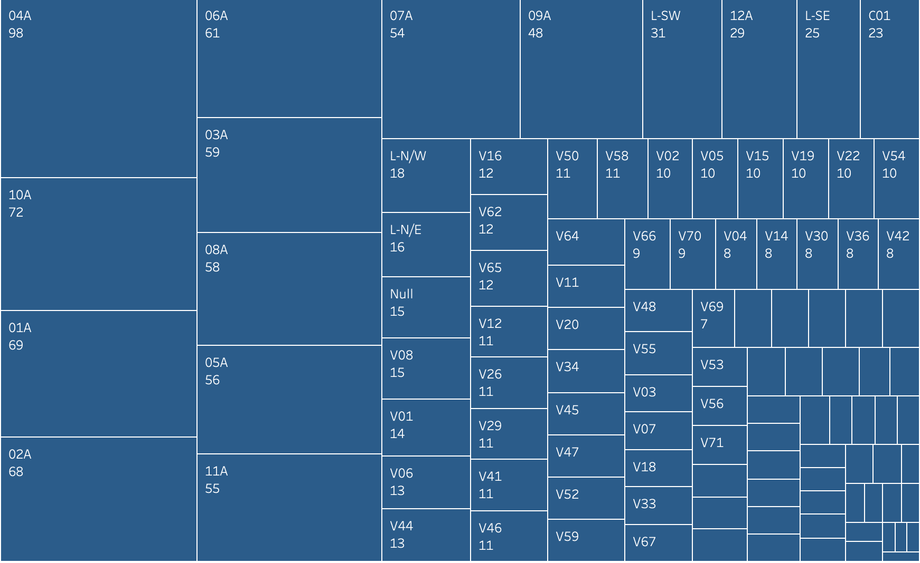
Number Of Clients In Each Route - 2021

Slide 10
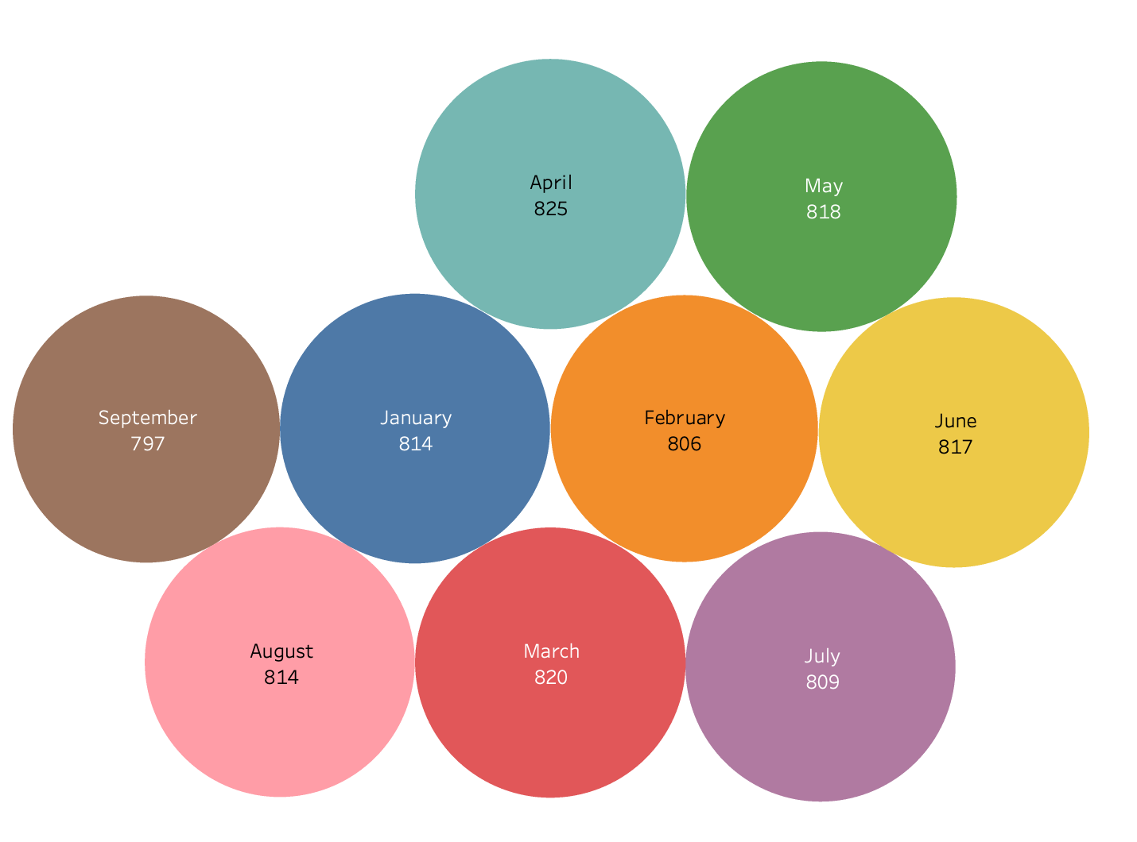
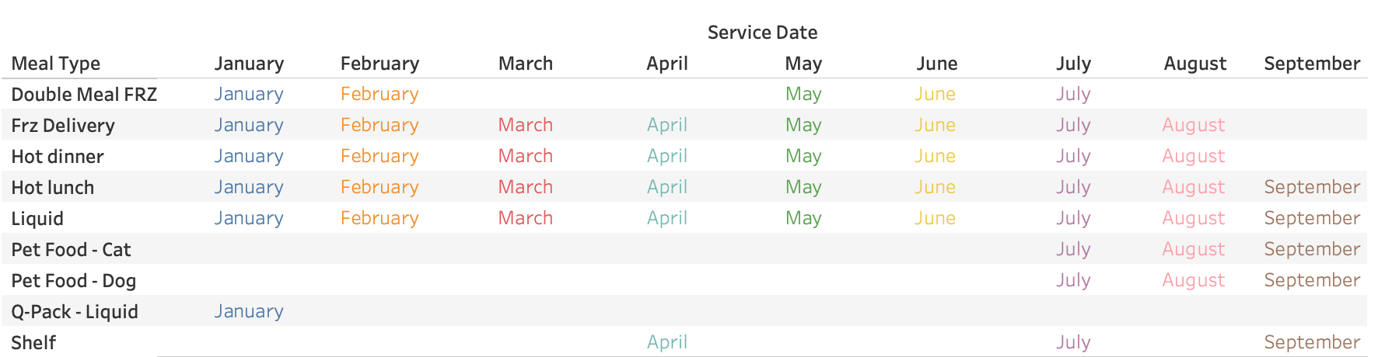
Monthly Services 2022

Slide 11
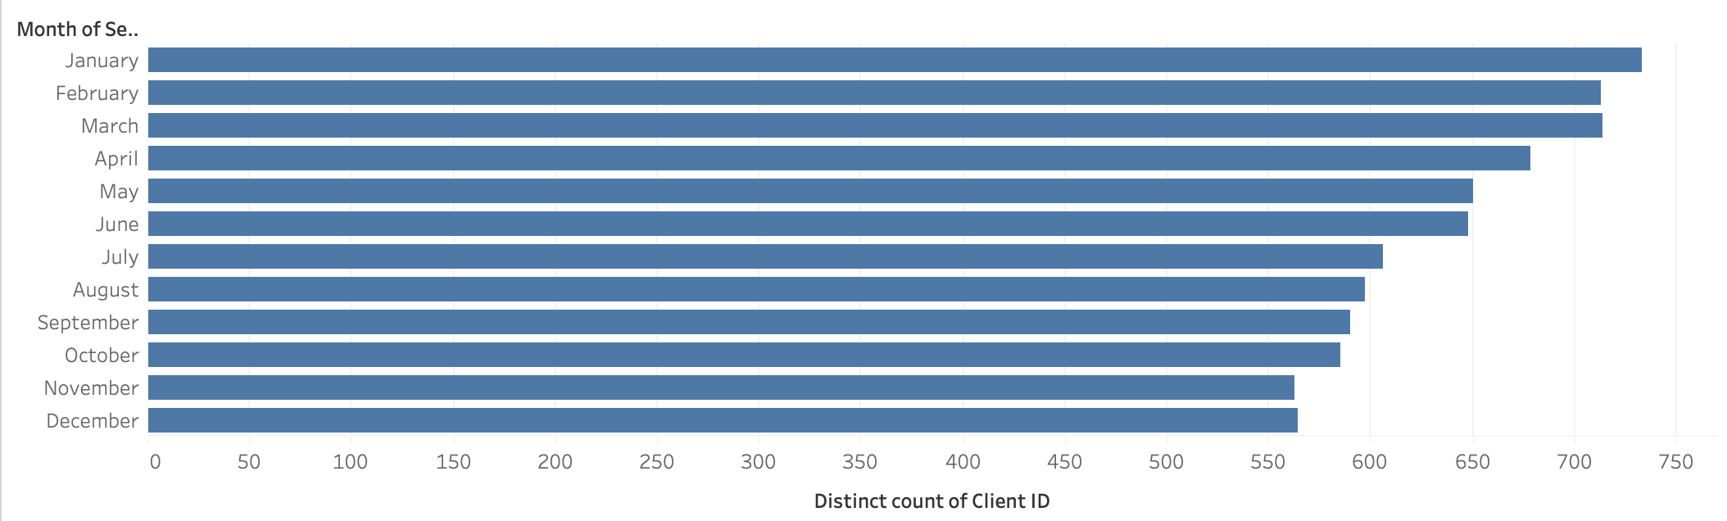
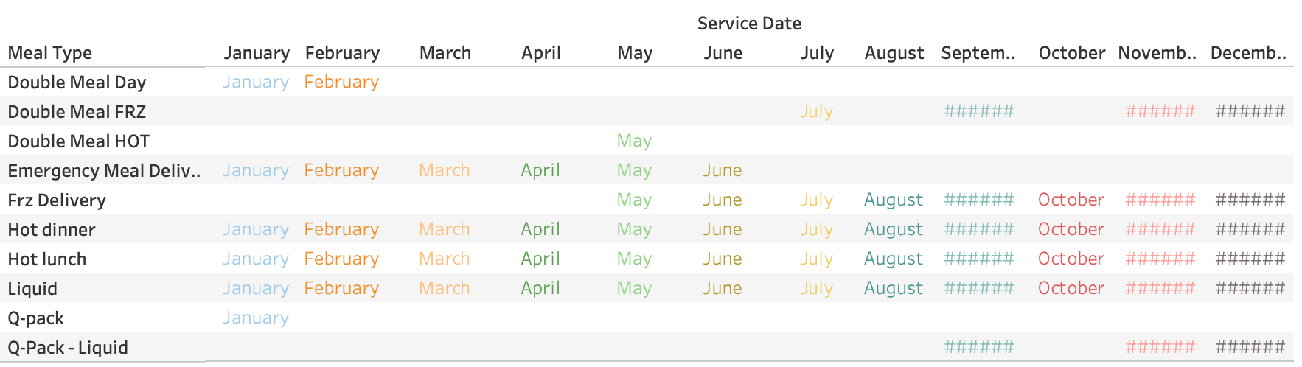
Monthly Services - 2021

Slide 12
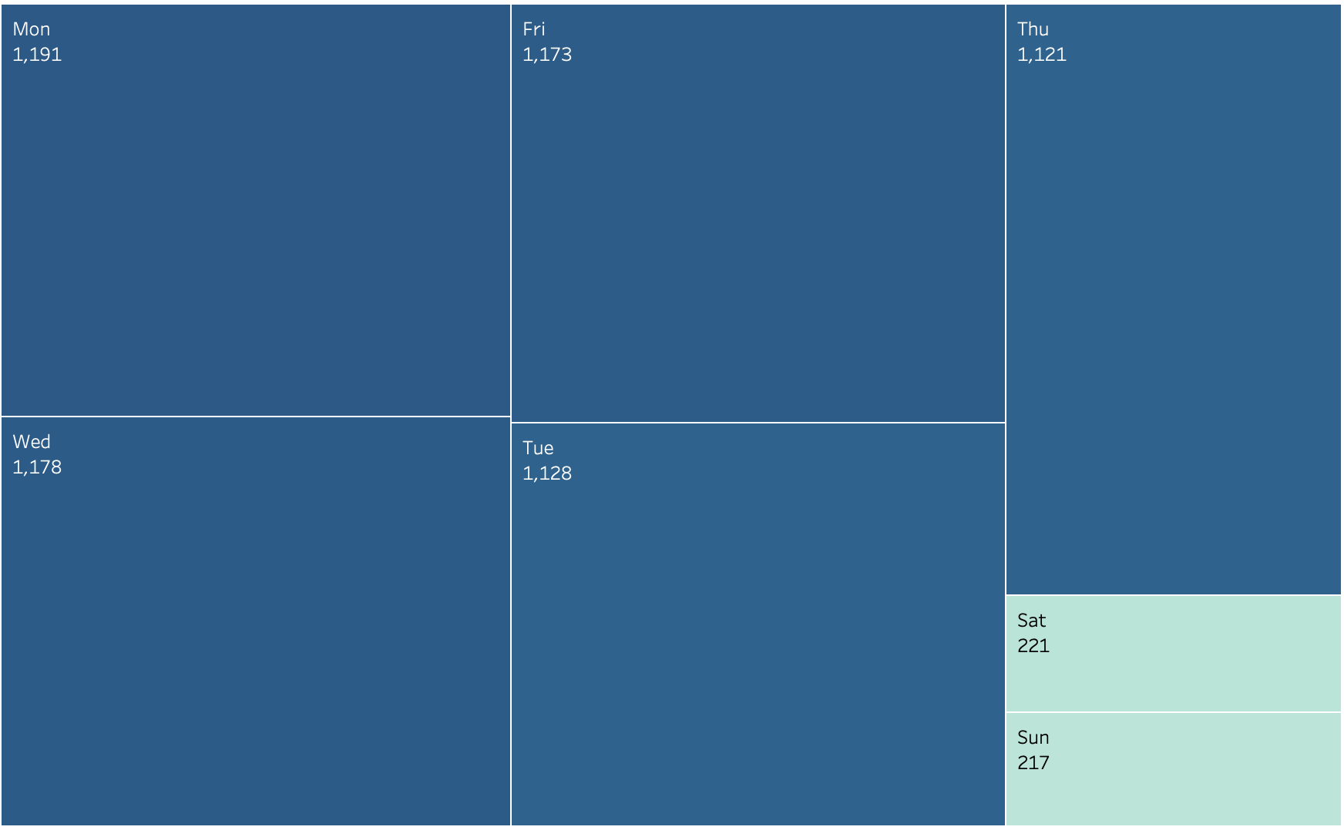
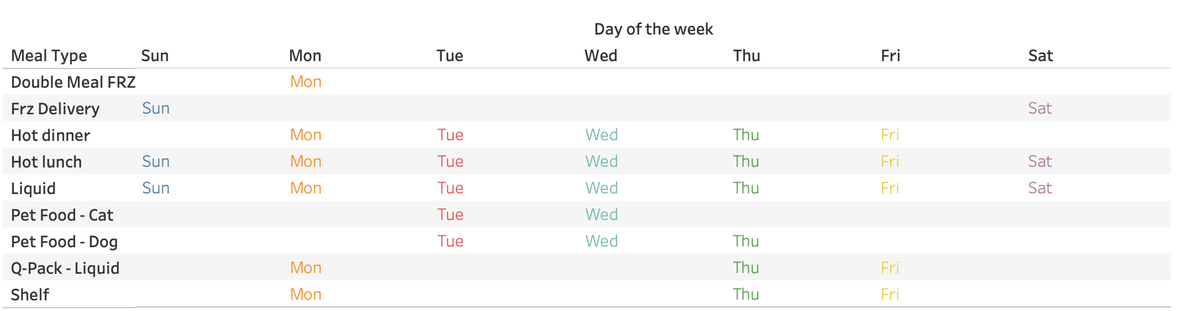
Weekly Services - 2022

Slide 13
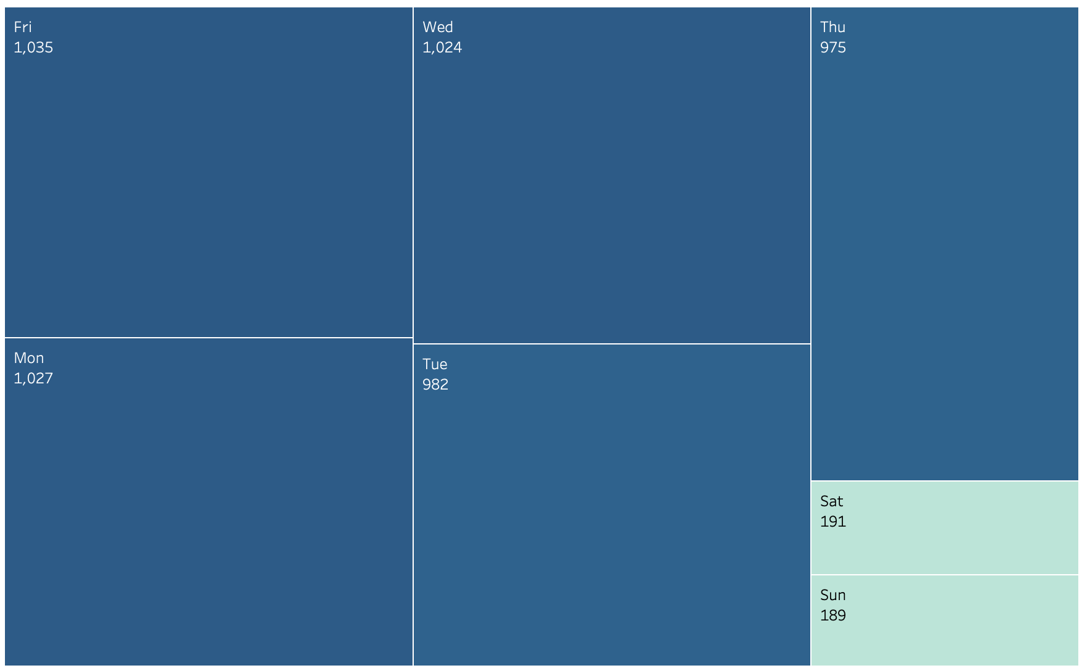
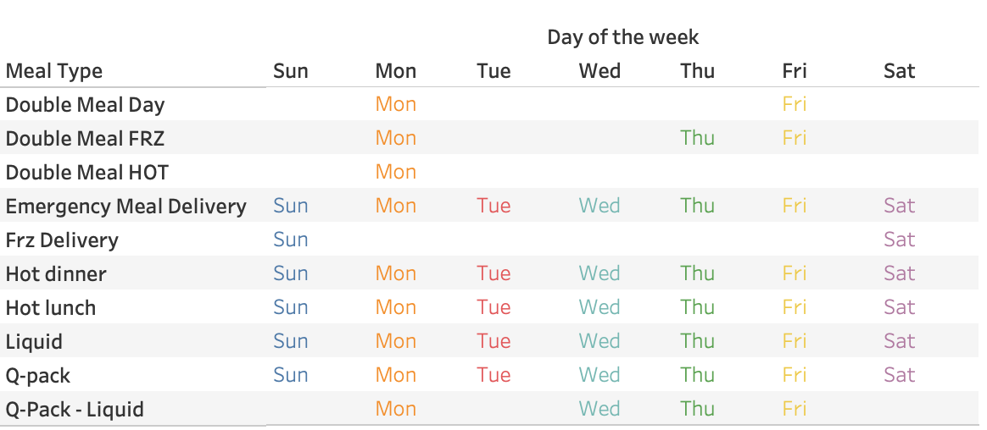
Weekly Services - 2021

Slide 14
Comparison
Year | Number of Clients
2022 | 1232
2021 | 1071
common | 566

Slide 15

Rides For Wellness Program

Slide 16
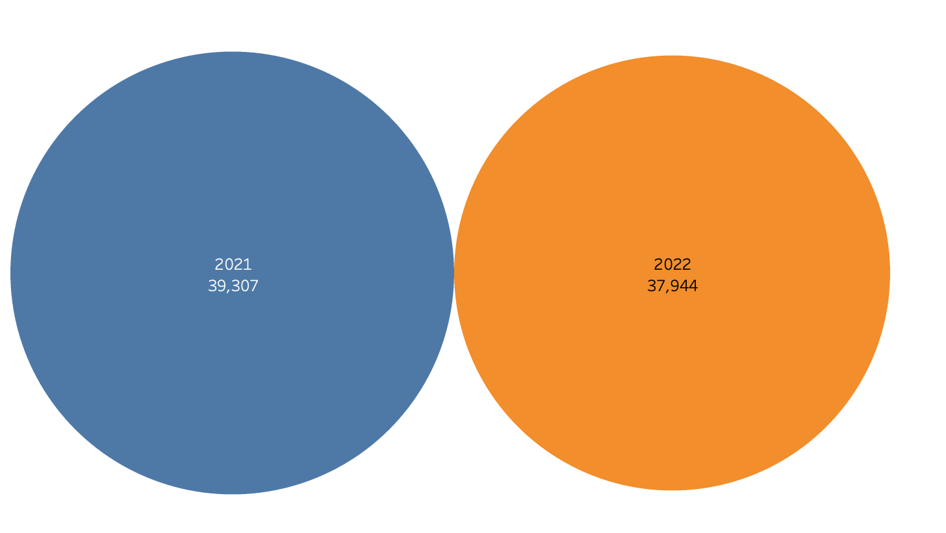
Total Rides in 2021 & 2022

Slide 17
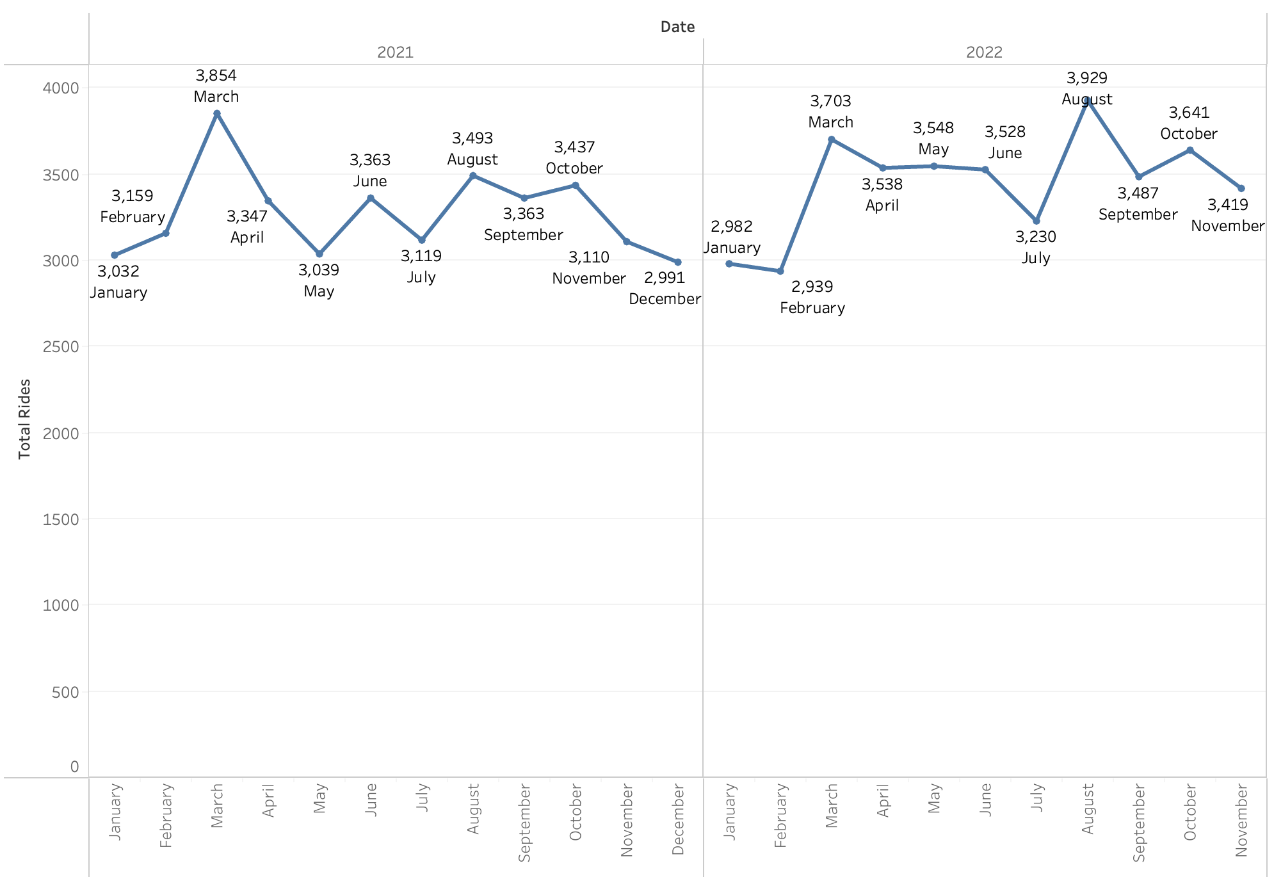
Seasonality

Slide 18
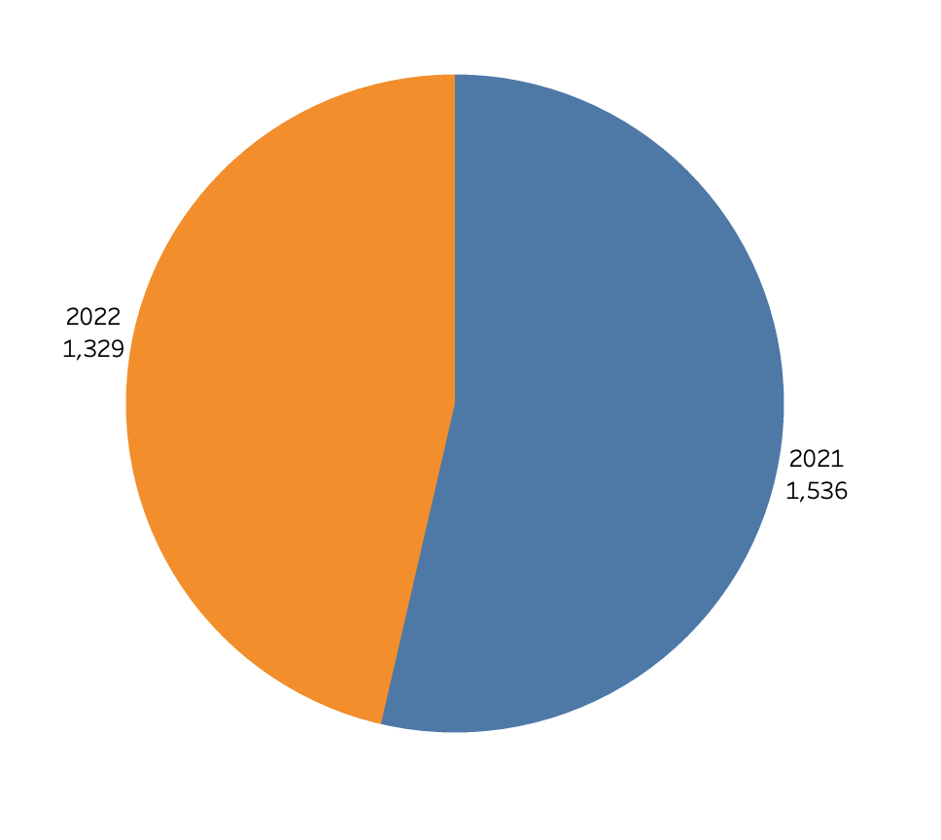
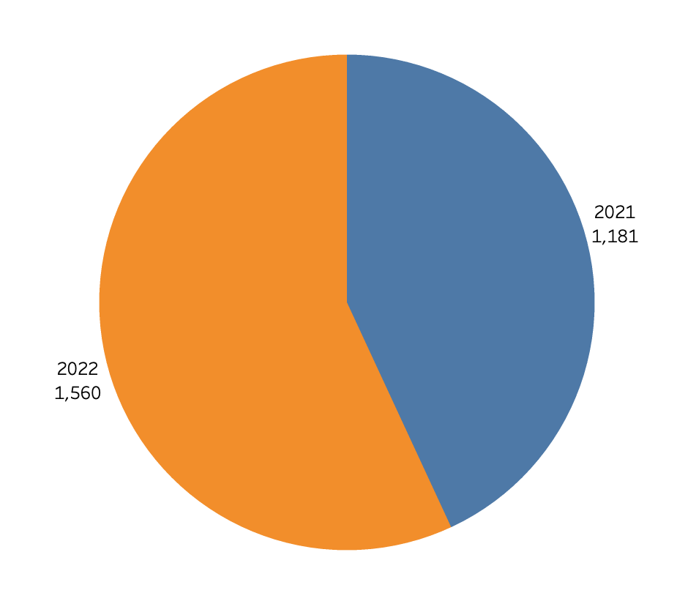
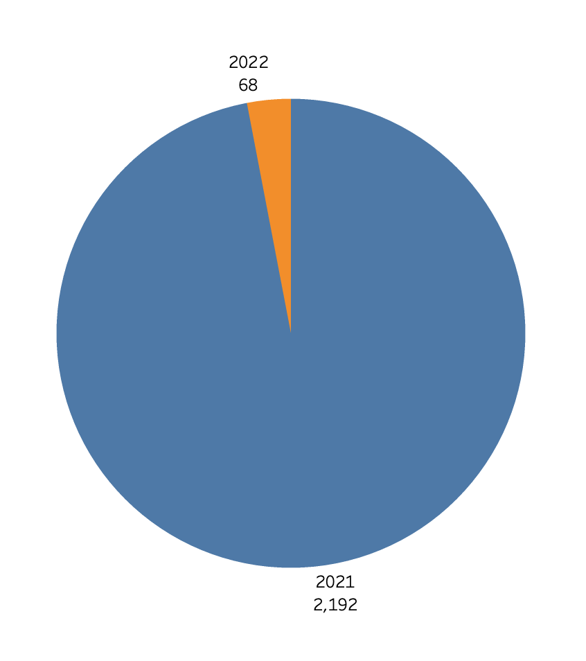
Vaccines
Dental
Cancer Treatment

Slide 19
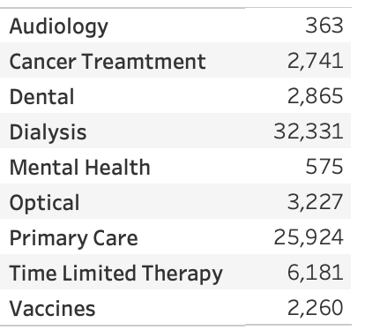
Rides for each Treatment

Slide 20
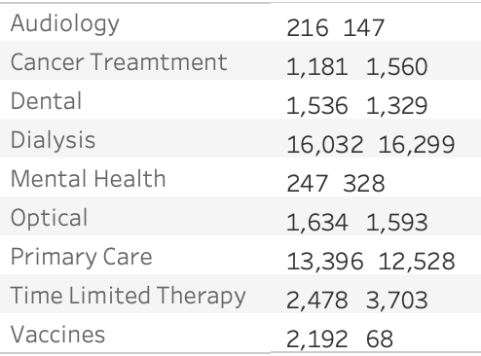
Yearly Rides
Mental health patients increased
Increase in cancer patients
Decrease in vaccines as by this time most of the people are vaccinated

Slide 21
Recommendations
Getting Feedback from the people receiving the services
Methods to handle emergency situations
Support staff
Hire people who are service oriented
Methods to deal with the mental health of the elderly
Fundraising

Slide 22

Thank You !!

Slide 23

Question ??

